Slide 1
PROJECT MANAGEMENT TOOL
Presented By:
Mr. Divyanshu Arora (240310120006)
Miss Mitali Shrivastava (240310120007)
Mr. Suraj Gupta (240310120013)
Guide:
Mr. Pankaj Kumar Mahto
Project Engineer, CDAC Delhi

Slide 2
INTRODUCTION
The goal of this project is to develop a comprehensive project management platform tailored to small-scale businesses.
The software will facilitate seamless project execution, team collaboration, and task management, thereby enhancing productivity and profitability.
Users can manage all project phases, from planning and execution to monitoring and closure, through a single, integrated platform.

Slide 3
Software Requirements
Designing End: React JS , HTTP Client using axios Library
Development End: Spring Boot Rest Controller, Autowiring is used as well to inject the Dependencies
Data Base : MySQL.
Web Server: TOMCAT Web Server.
Tools : VS Code, Spring ToolSuit4, MySQL Workbench 8.0 CE, Browser

Slide 4
ReactJS-
Component-Based Architecture
Virtual DOM for optimized rendering
JSX syntax for mixing HTML with JavaScript
Unidirectional data flow for better control of application state
Axios Library-
Supports all HTTP methods (GET, POST, PUT, DELETE, etc.)
Automatic transformation of JSON data
Request and response interceptors for handling requests globally
Supports request cancellation, timeouts, and protection against Cross-Site Request Forgery
SpringBoot Rest Controller-
Simplifies the development of RESTful APIs
Auto-configuration to reduce boilerplate code
Supports dependency injection using Spring's powerful IoC container
In-built support for common web development tasks (e.g. data validation, error handling)

Slide 5
Autowiring in SpringBoot-
Reduces boilerplate code by automatically injecting dependencies
Supports various types of autowiring (by type, by name, by constructor)
Enhances modularity and testability of the application
MySql Database-
It supports ACID (Atomicity, Consistency, Isolation, Durability) properties for reliable transaction management
High performance and scalability for handling large datasets.
Integration with various programming languages and frameworks

Slide 6
Proposed Solution
A comprehensive project management tool specifically designed to address the challenges faced by small to medium-sized businesses.
This tool integrates modern technologies and best practices to provide an efficient, scalable, and user-friendly platform for managing projects, resources, and team collaboration.
The solution is built with a focus on simplicity, flexibility, and security, ensuring that it meets the unique needs of small businesses while remaining cost-effective.

Slide 7
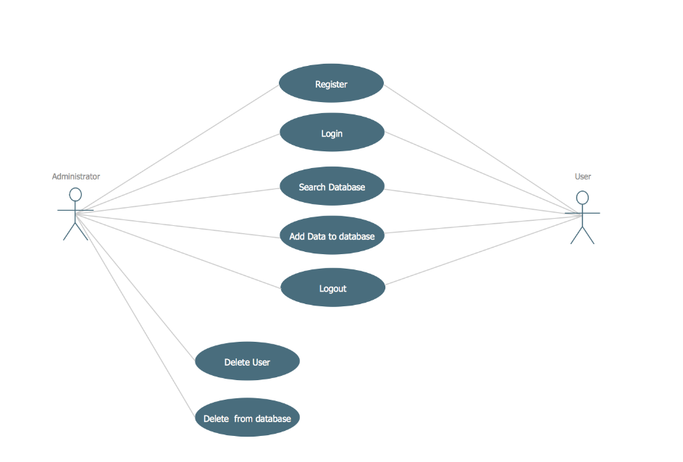
System Architecture:

Slide 8
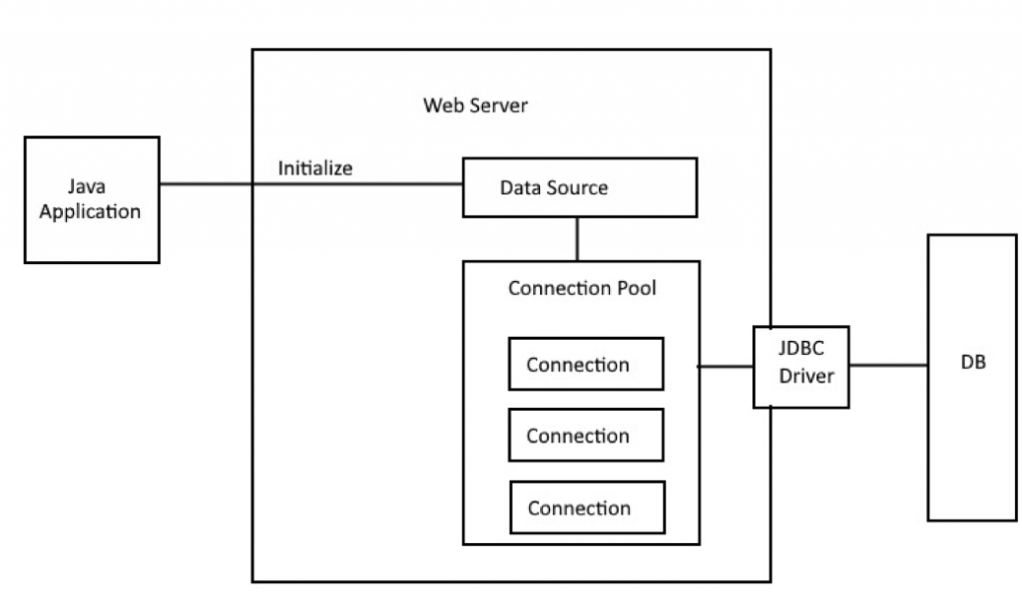
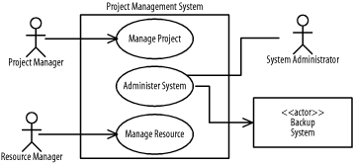
ER Diagram:

Slide 9
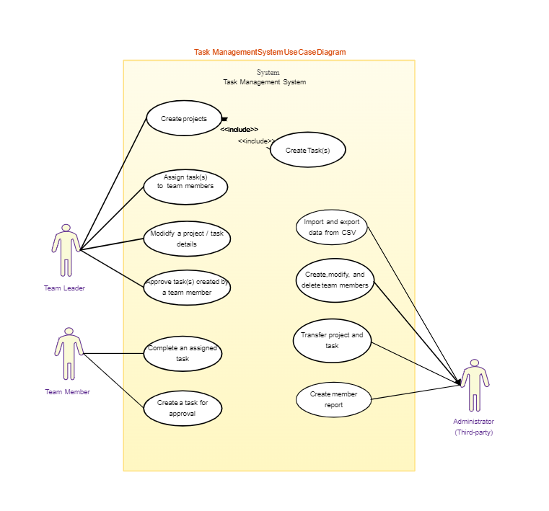
Use-case Model

Slide 10
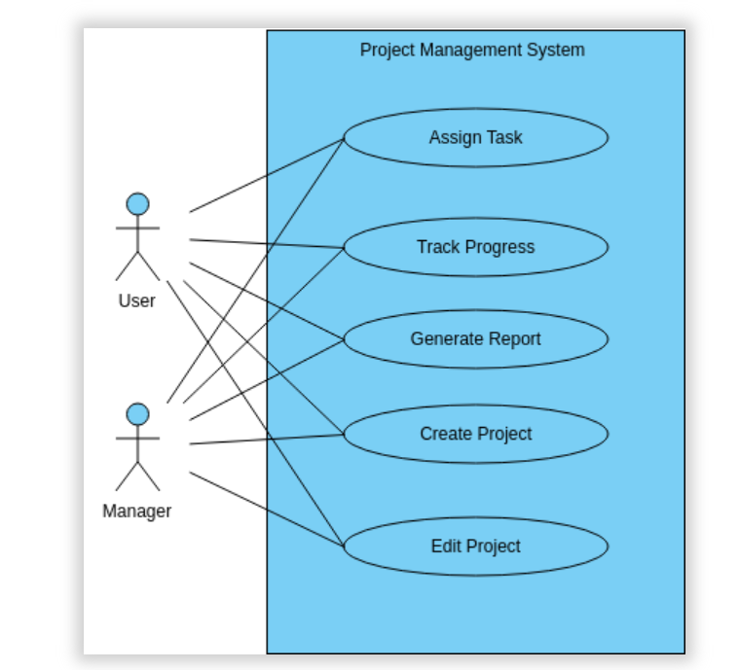
Admin Case

Slide 11
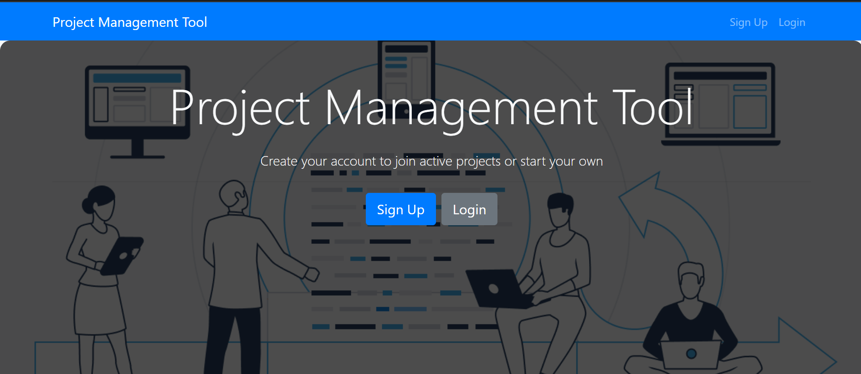
Implementation:
Home page:

Slide 12
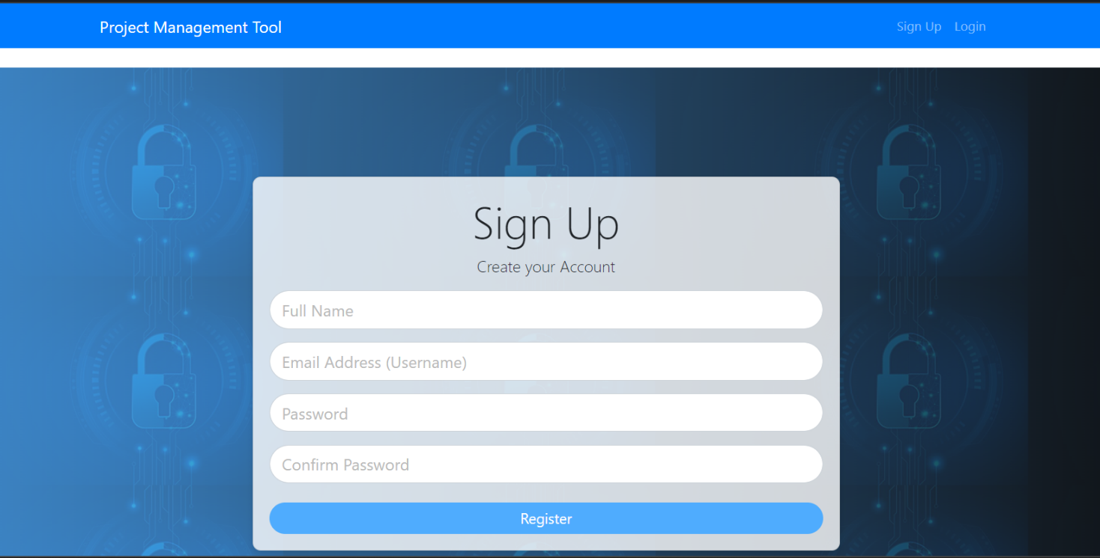
Register page:

Slide 13
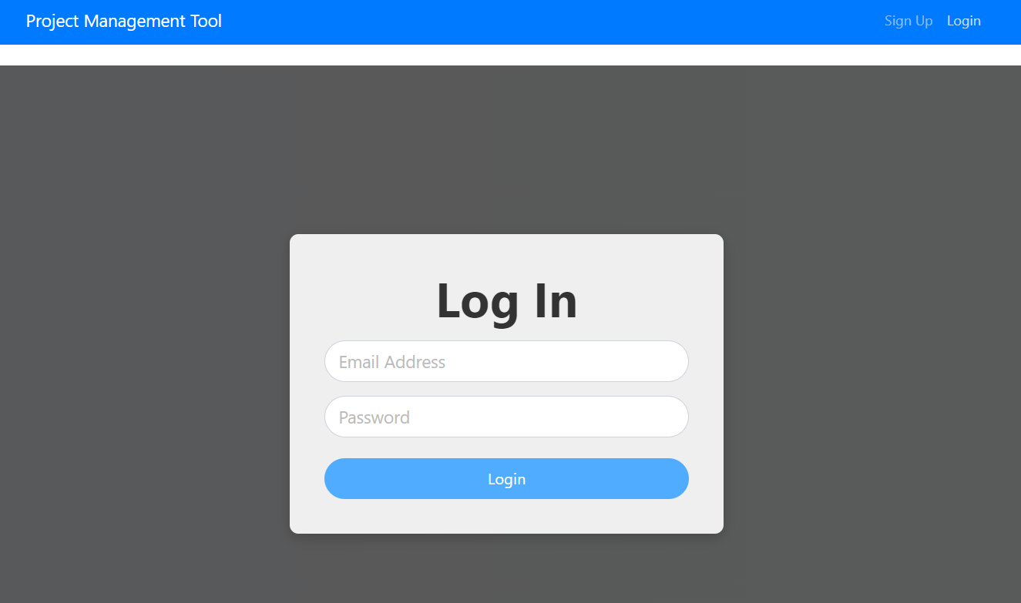
User login page:

Slide 14
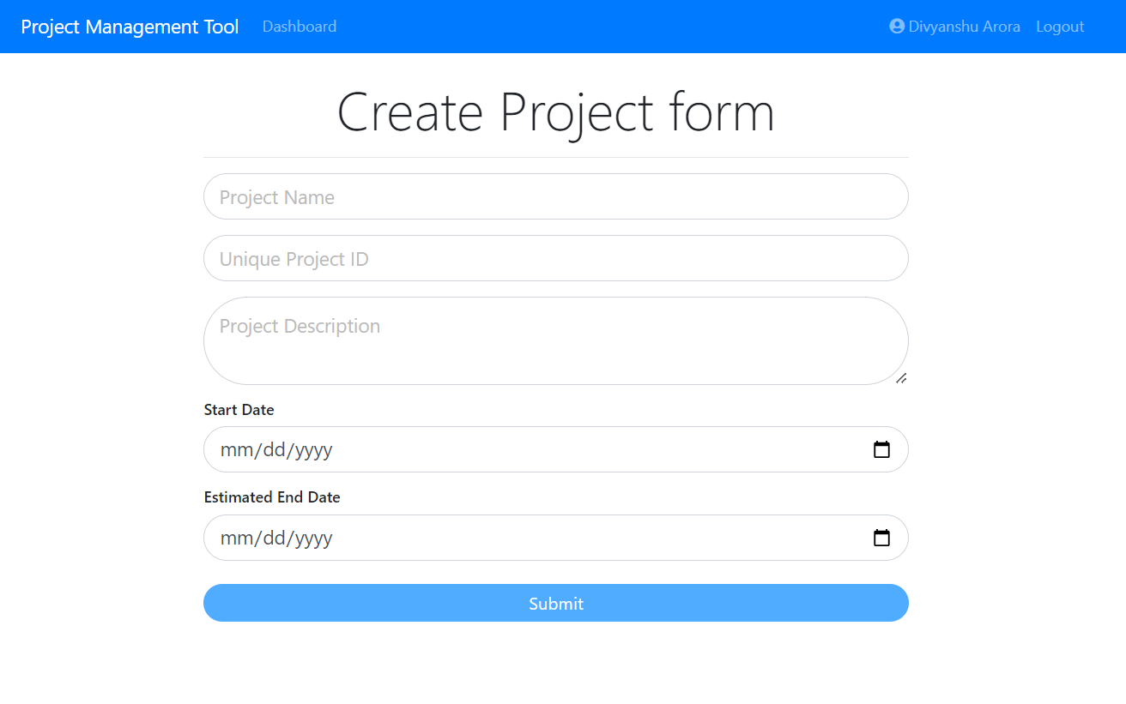
Project Creation :

Slide 15
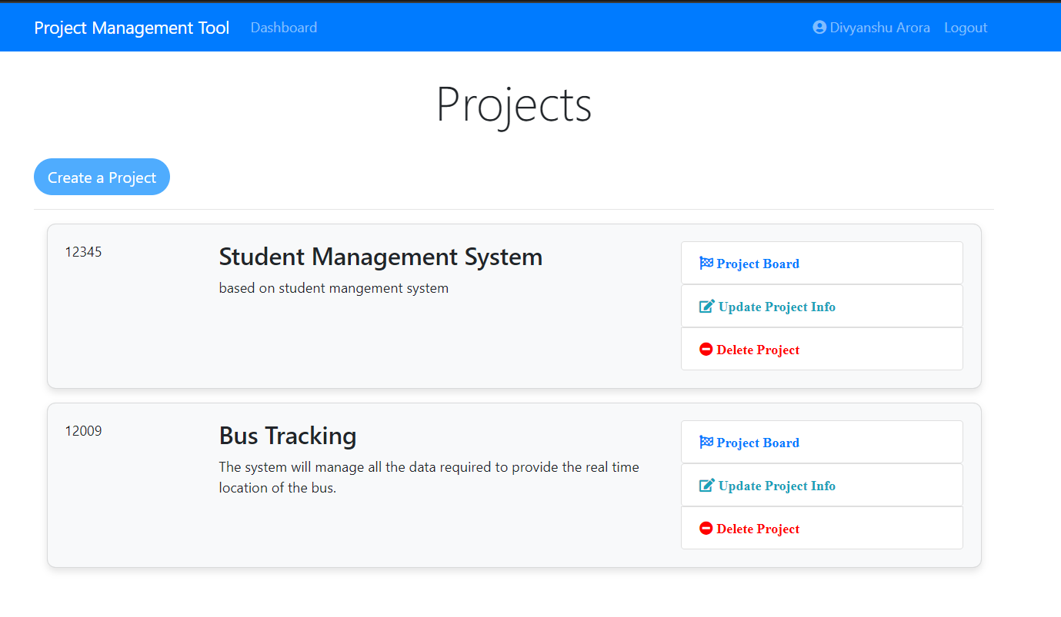
Project Details Page

Slide 16
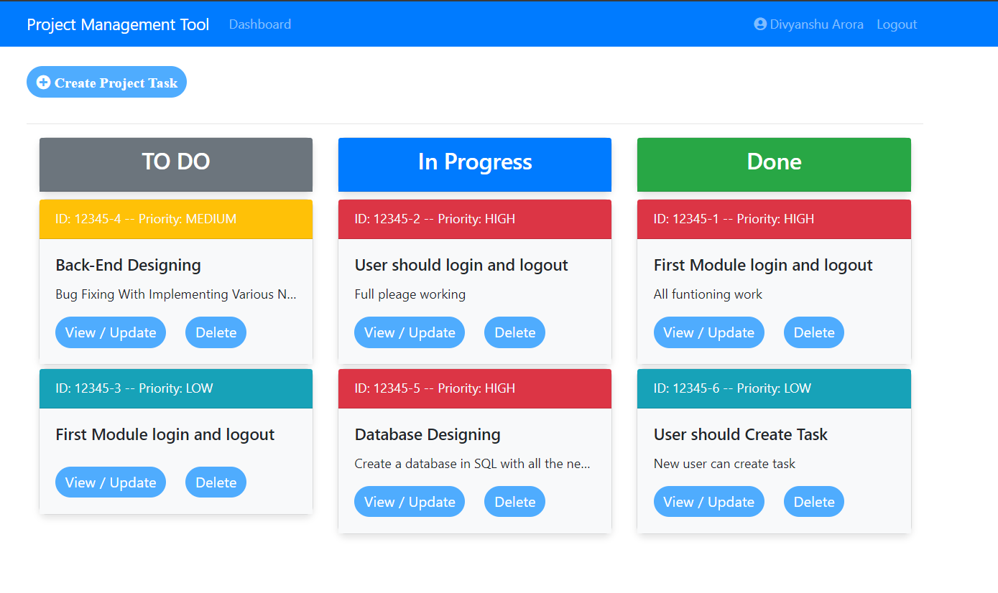
Project Board:

Slide 17
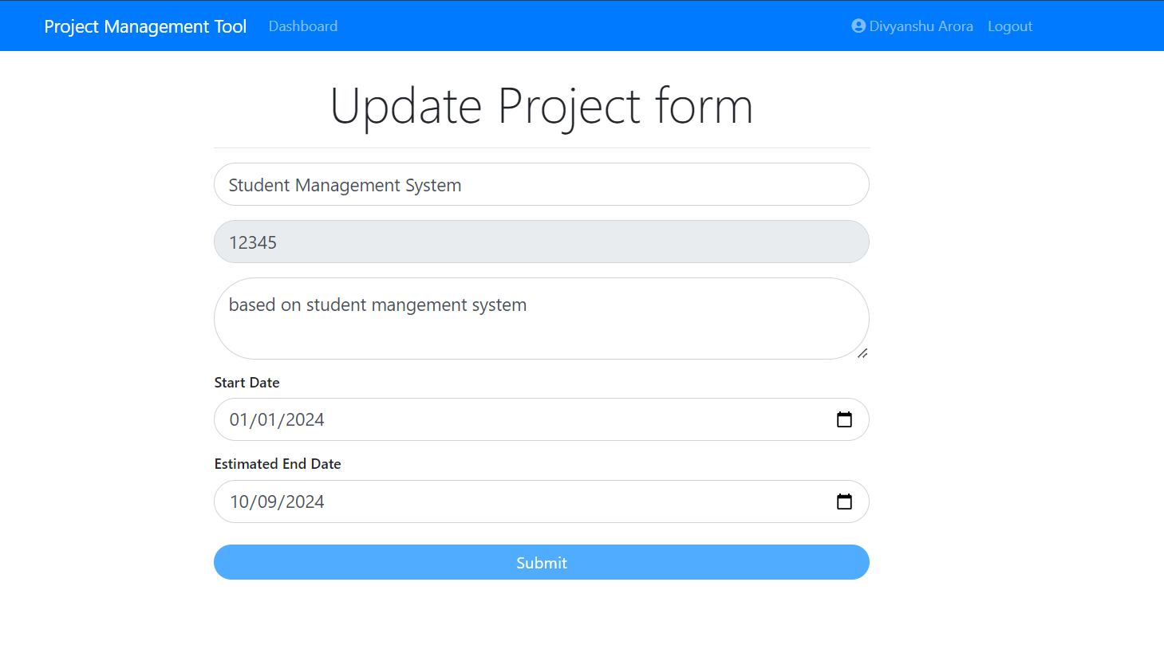
Update Project Details:

Slide 18
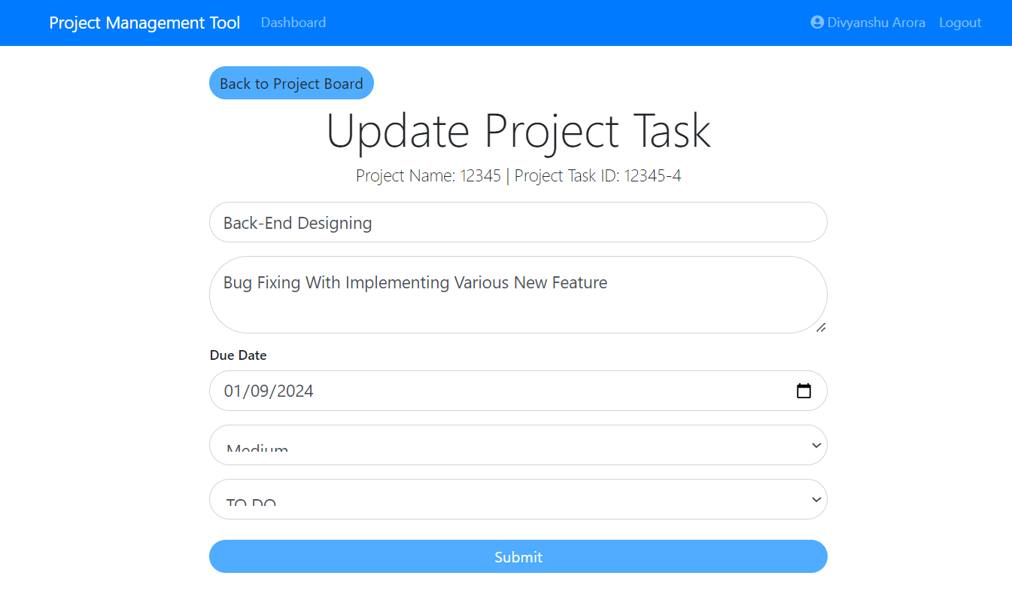
Update Project Task Details:

Slide 19
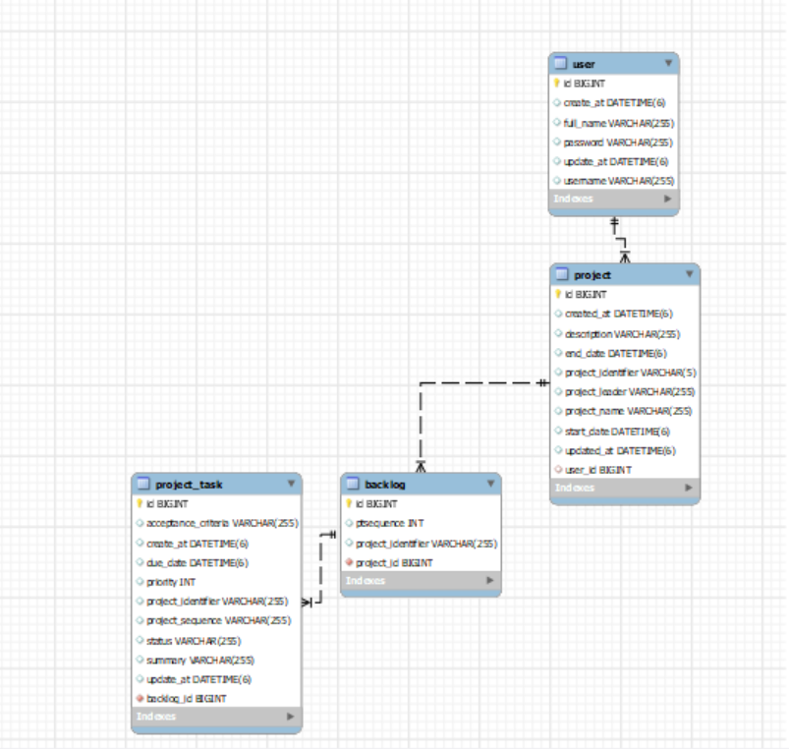
Database Design:

Slide 20
FUTURE SCOPE
The system will support different user roles, including Admin, Project Manager, and Team Member.
Users will be able to create, assign, prioritize, and track tasks within projects. Tasks can be categorized and filtered based on their status, priority, and deadlines, allowing for efficient task management.
The platform will include communication tools such as messaging, file sharing, and real-time notifications to facilitate collaboration among team members.
The tool will implement robust security measures to protect sensitive project data. This includes secure authentication, encryption of data, and regular backups to prevent data loss or breaches.
Users will have the ability to customize certain aspects of the tool, such as project templates, task categories, and user interface themes, to better suit their specific workflow and preferences.

Slide 21
The project management tool will be designed to scale according to the needs of the organization. Whether managing a single project or multiple concurrent projects, the tool will support growth without compromising performance.
The tool will provide budget tracking features, allowing project managers to monitor expenses against the project budget. This will help in managing project costs and ensuring financial efficiency.
The platform can offer client access features where clients can view project progress, provide feedback, and approve completed tasks. This enhances client engagement and satisfaction.

Slide 22
CONCLUSION
The platform offers a convenient and effective solution for managing small-scale projects, with an emphasis on user-friendly design and secure operations.
We define the problem on which we are working in this project.
We designed the simple user interface and resolved security issues of the system.
Finally, system is implemented and tested accordingly to the test cases.
At personal level we learned to work with team, implement software development technology and principles and good programing practice.

Slide 23
THANK YOU…

